Slide 1
Design and Implementation of an Integrated Smart Vehicle Safety System
W.M.S.F Weerasinghe
D/ENG/23/0201/ET
STREAM: ET
Progress Presentation of Individual Design Project

Slide 2
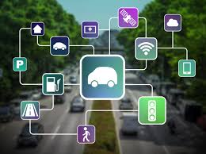
Content of the Presentation
Problem Identification
Objectives
Literature Review
Market Survey
Main Components
System Design
Results and Discussion
Problems Encountered and Solutions
Cost Estimation
Gantt Chart
References

Slide 3
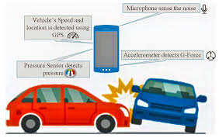
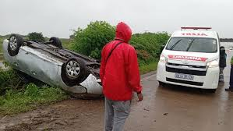
Problem Identification
Missed Safety Alerts: Drivers often miss important warnings
No Incident Records: Lack of detailed records after incidents makes learning from mistakes hard.
Poor Location Tracking: Inaccurate tracking can delay emergency responses.
Limited Solutions: Current systems lack integration of multiple safety features.

Slide 4

Objectives
Develop an ESP32-based system for real-time vehicle monitoring.
Detect critical conditions such as alcohol presence, collisions, overheating, and nearby obstacles.
Track vehicle location using GPS for enhanced situational awareness.
Deliver immediate emergency alerts through GSM communication.

Slide 5
Literature Review
Vehicle safety has been a key area of research, particularly with the rise of smart technologies and the Internet of Things (IoT). Various studies have focused on enhancing accident detection, prevention, and emergency response through modern communication and sensing technologies.
proposed an IoT-based smart system for accident detection, notification, and prevention, integrating multiple sensors to monitor vehicle conditions and detect accidents in real time. Once an accident occurs, the system sends alerts to emergency contacts, helping to reduce response time and minimize fatalities. [1]
developed a Vehicle Safety Detection and Alarm System that prioritizes real-time monitoring of vehicle safety parameters. By employing advanced sensing techniques, the system detects potential hazards and warns the driver before an accident happens. This proactive approach emphasizes accident prevention rather than just detection. [2]

Slide 6
designed a Smart Vehicle Safety Monitoring System using the CAN protocol, enabling efficient communication between vehicle components for real-time monitoring and fault detection. The use of CAN technology enhances data transmission reliability, making the system well-suited for modern vehicles. [3]
introduced an IoT-Based Smart Accident Detection and Alert System that collects real-time data to identify accidents. Upon detection, emergency alerts are sent to predefined contacts and authorities. Their research underscores the importance of IoT in ensuring faster emergency responses. [4]
proposed an IoT-based Smart Emergency Response System (SERS) capable of monitoring vehicle, home, and health conditions. By broadening its scope beyond vehicles, this system ensures early detection of accidents and health-related emergencies, facilitating immediate intervention and providing a more comprehensive safety solution. [5]

Slide 7
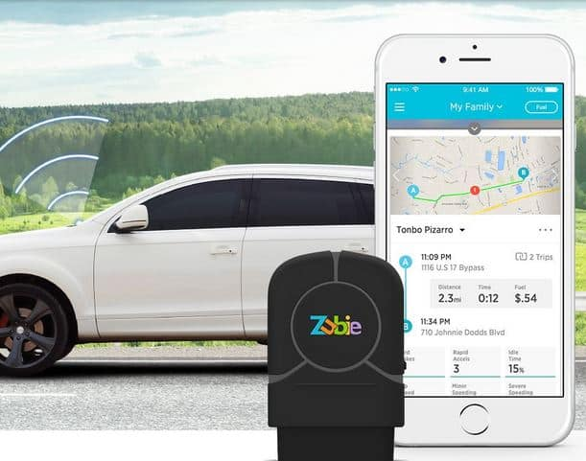
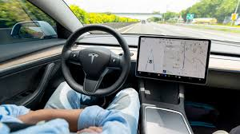

Market Survey
Zubie Connected Car
GPS Tracking
Real-Time Alerts
Cloud Connectivity
BlackVue DR900X Series
GPS Tracking
Video Recording
Real-Time Alerts
Cloud Connectivity
Tesla Autopilot
GPS Tracking
Real-time alerts
Cloud connectivity
Voice Control

Slide 8
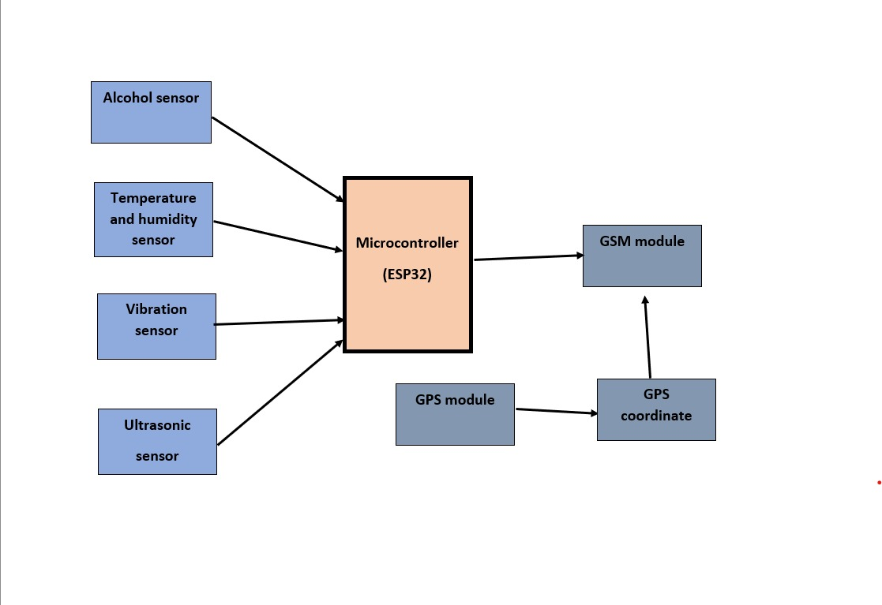
System Design

Slide 9
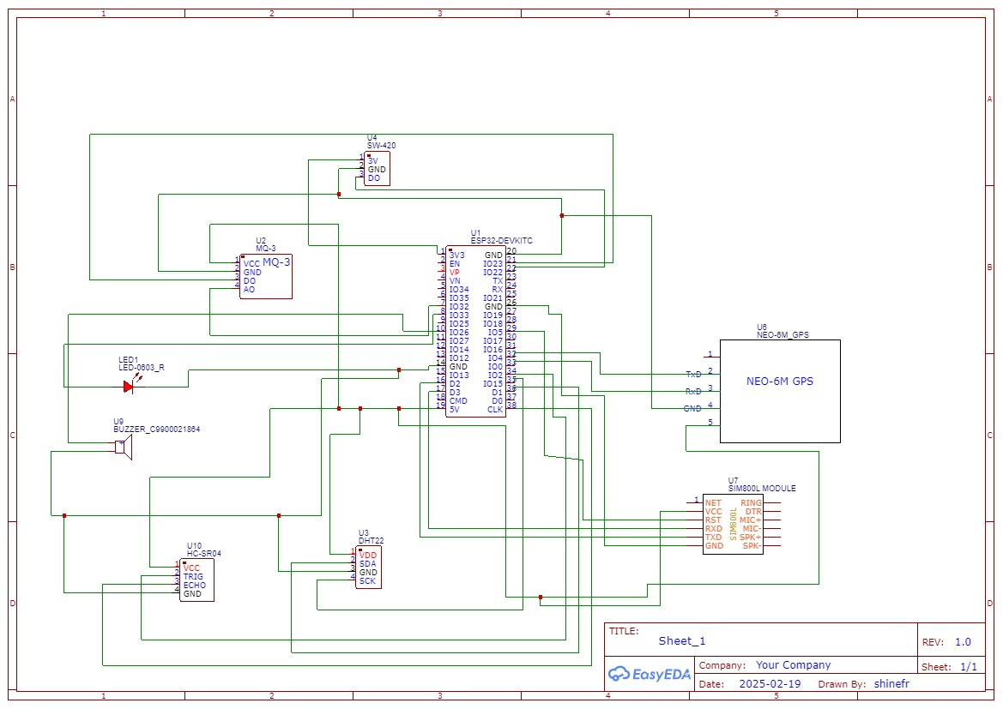
Circuit Diagram

Slide 10
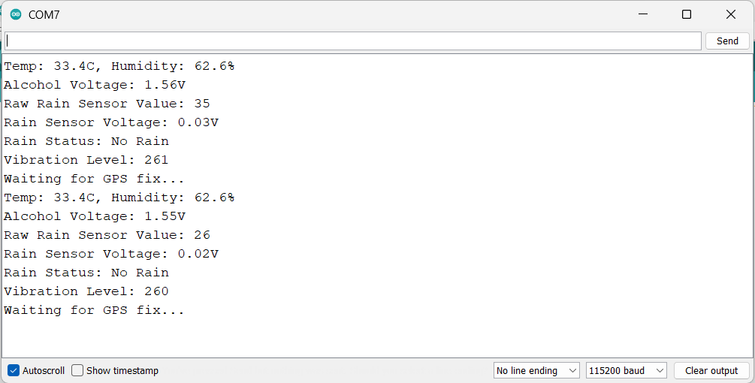
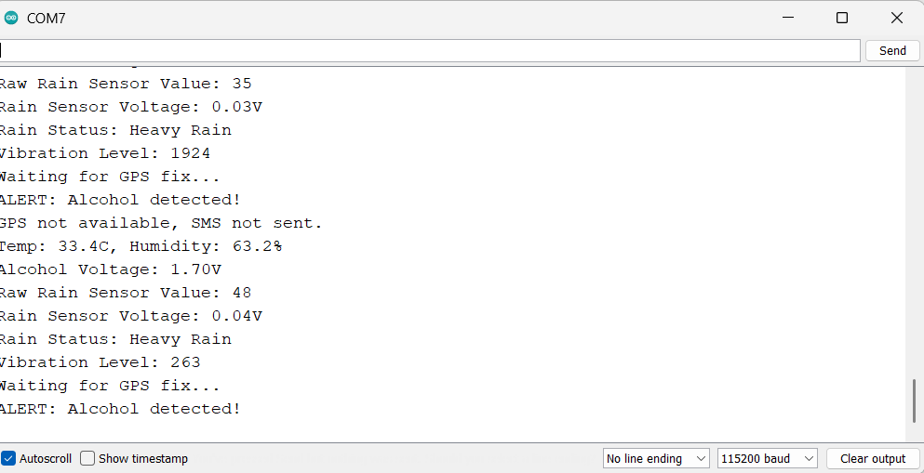
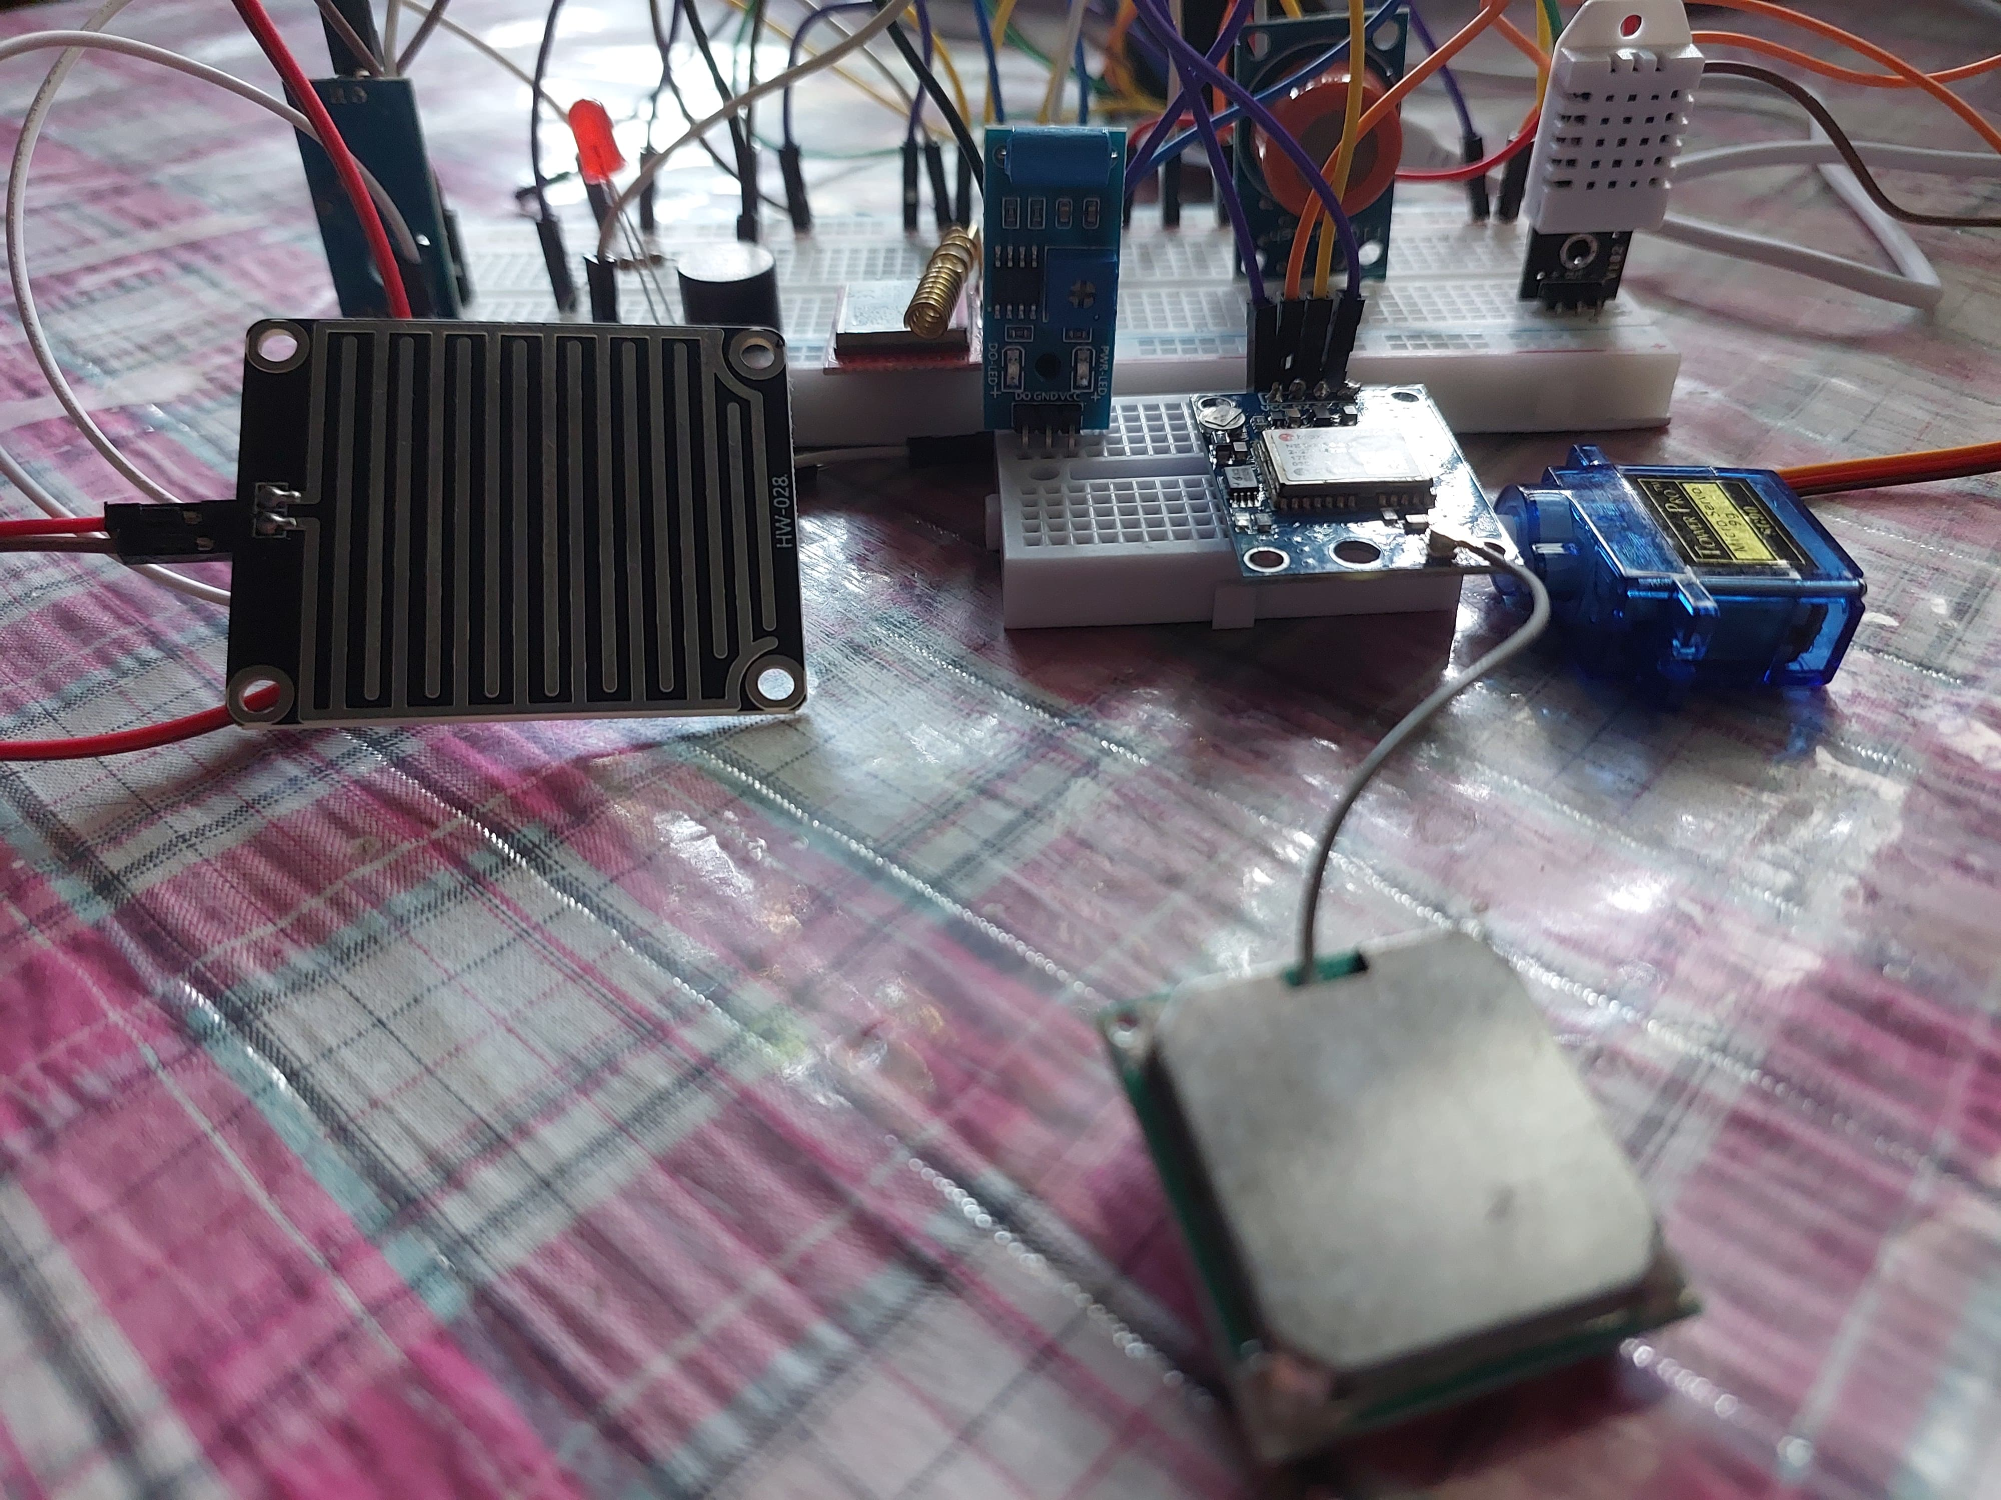
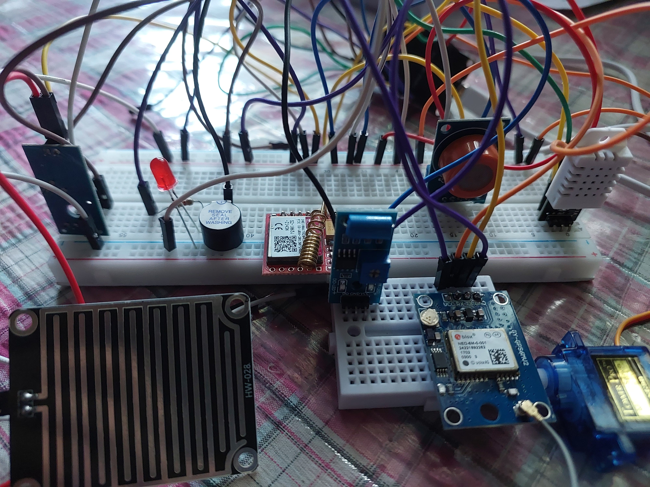
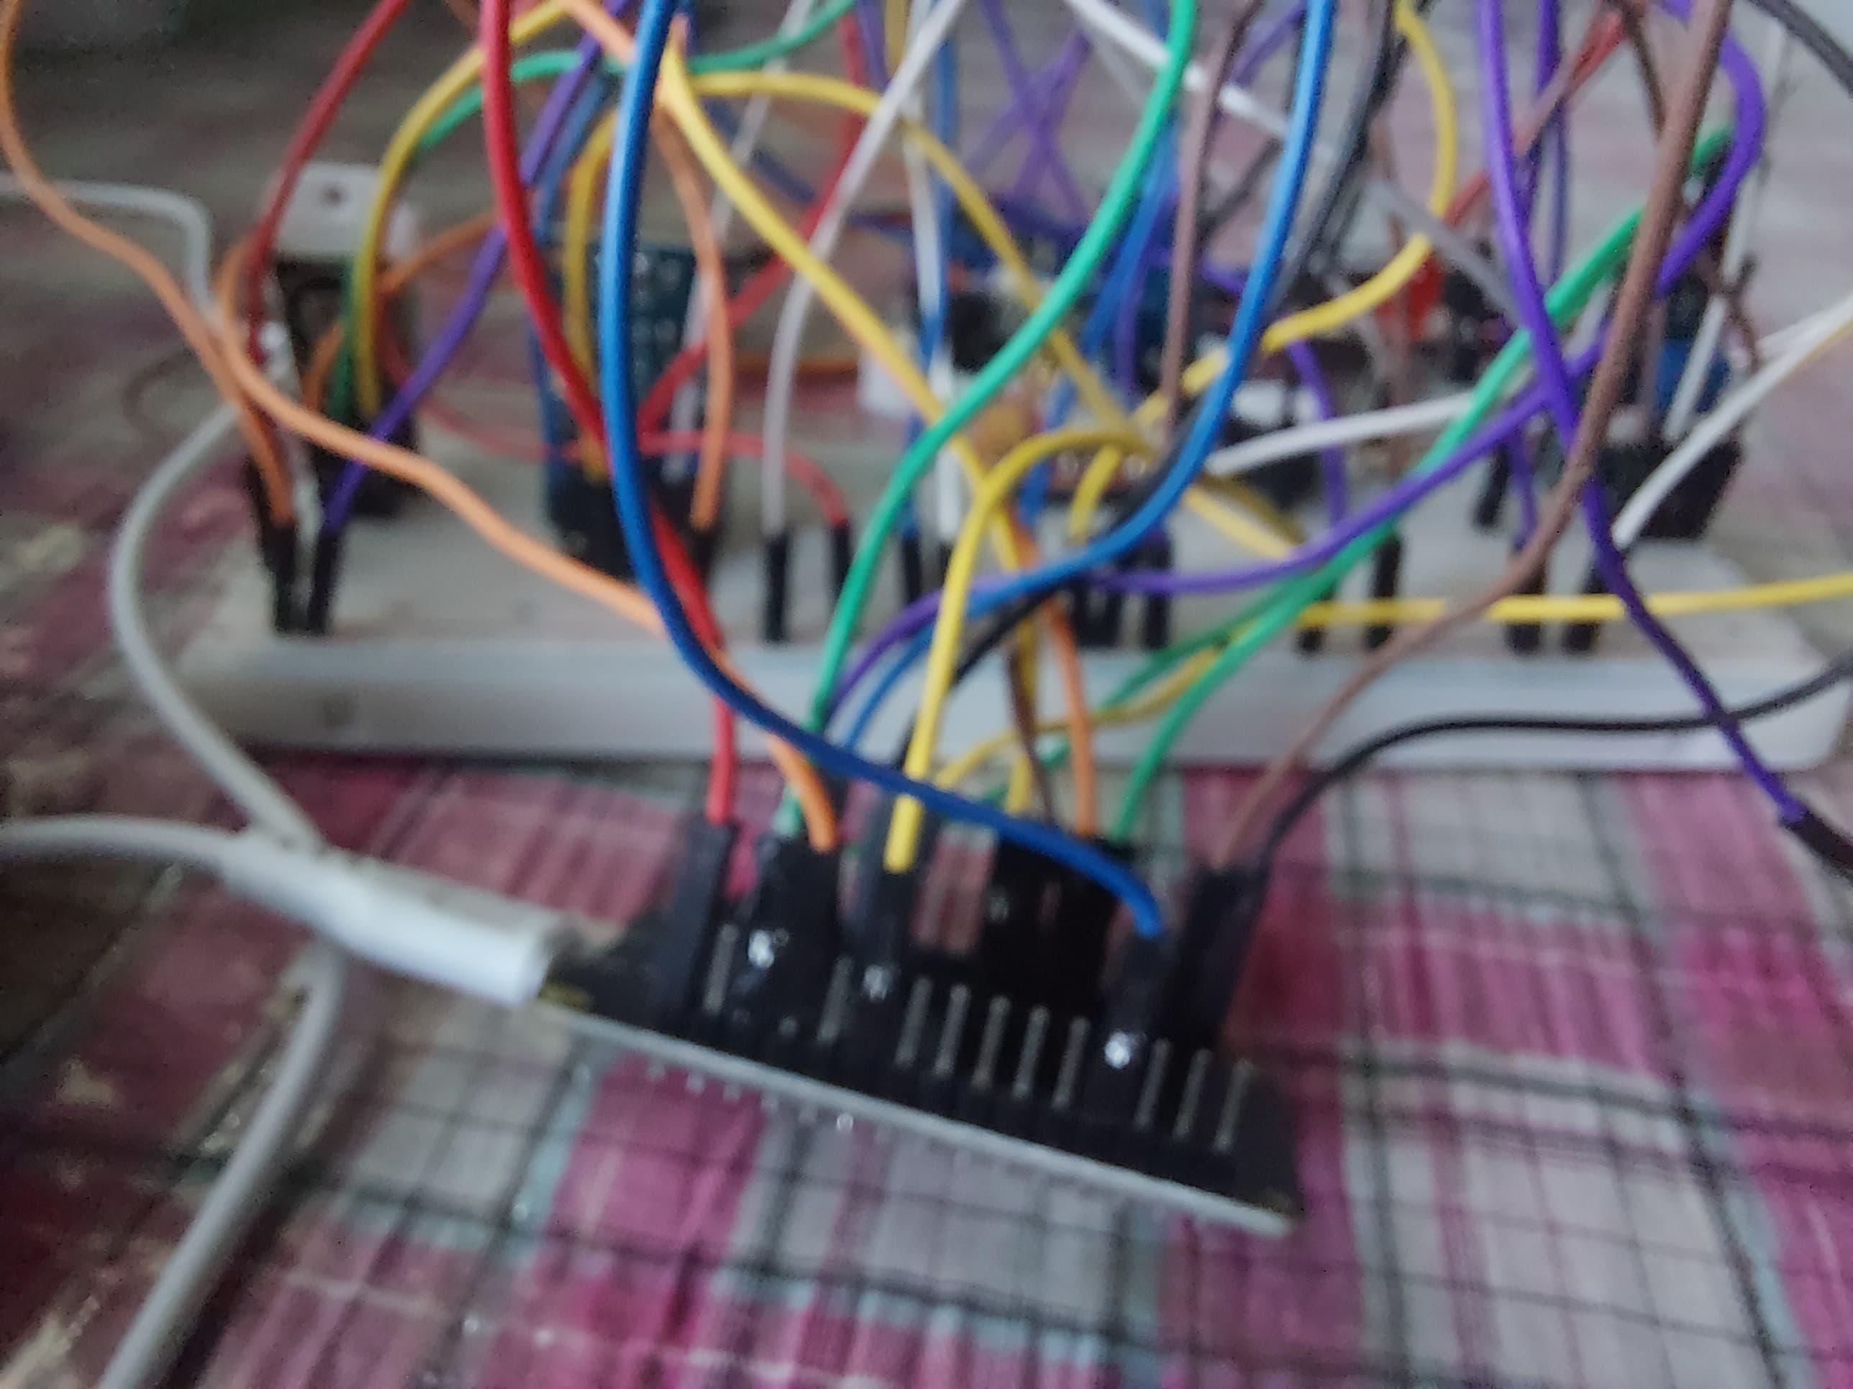
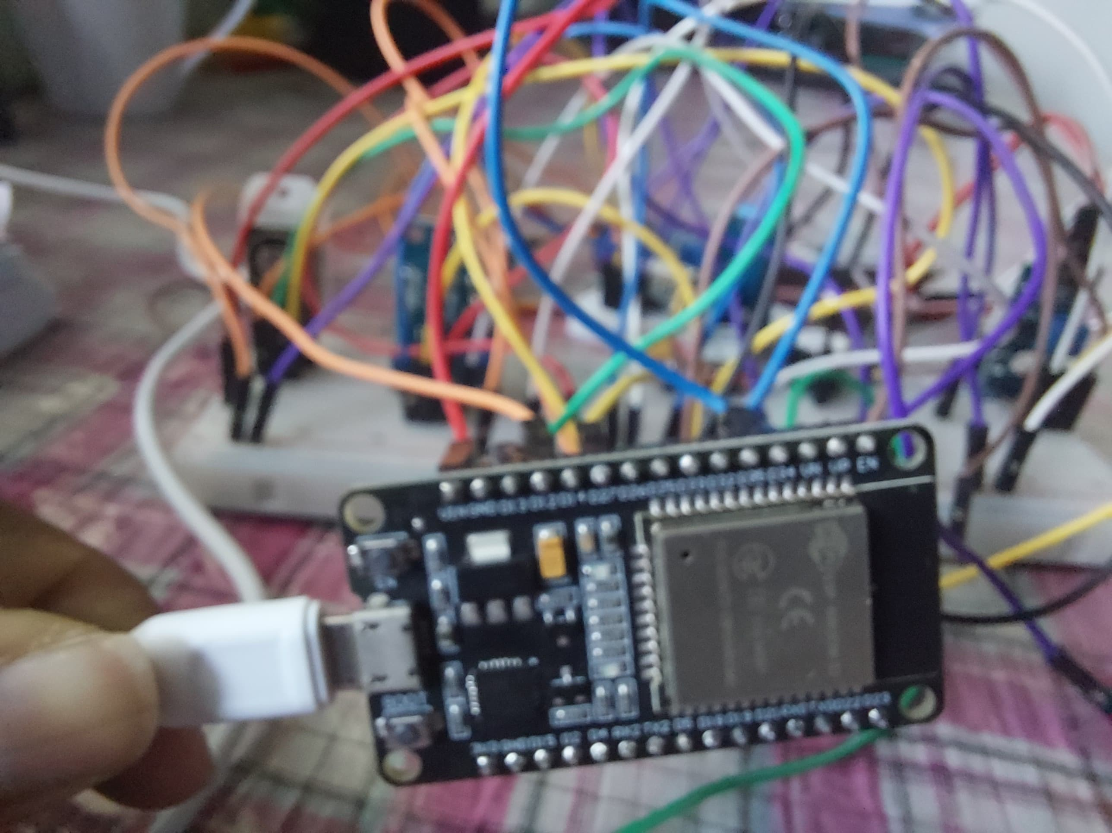

Slide 11
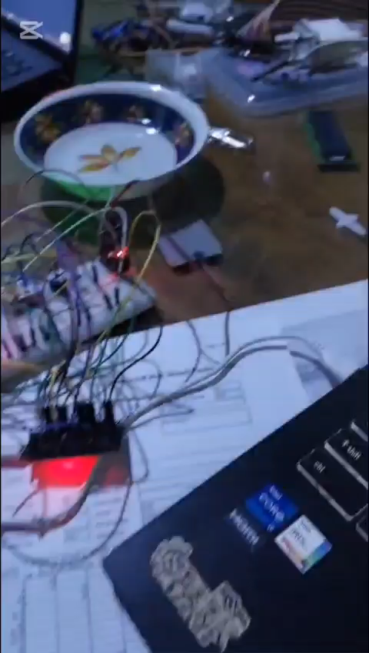
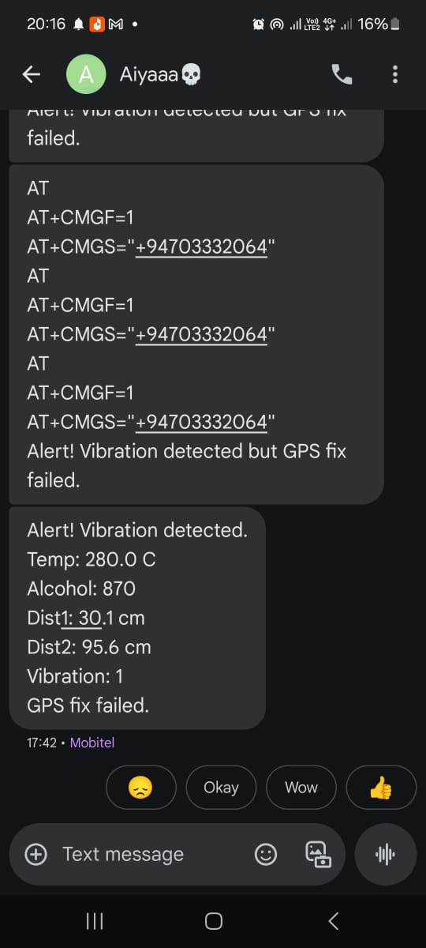
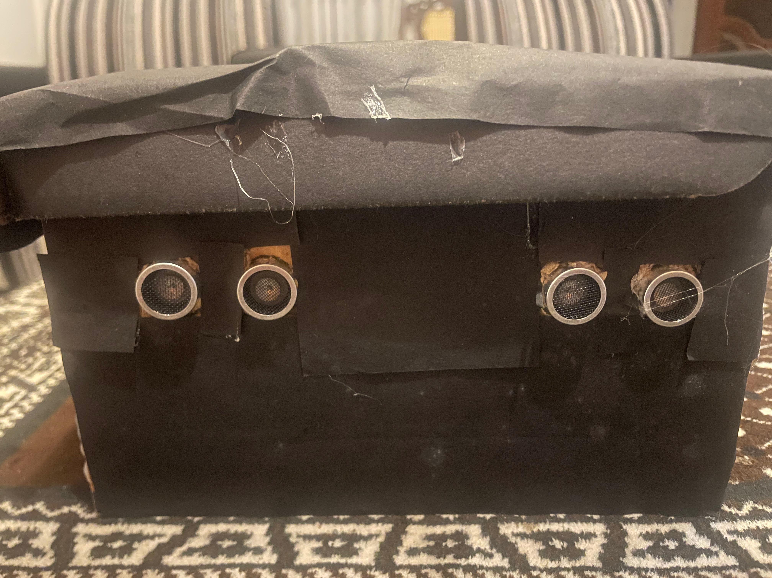
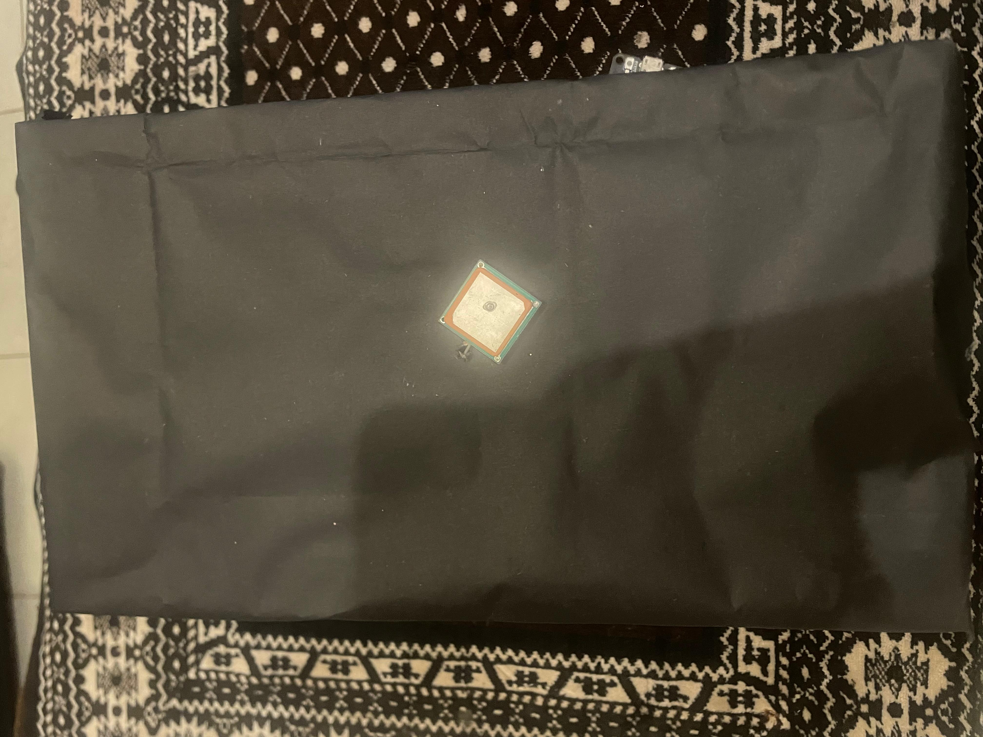
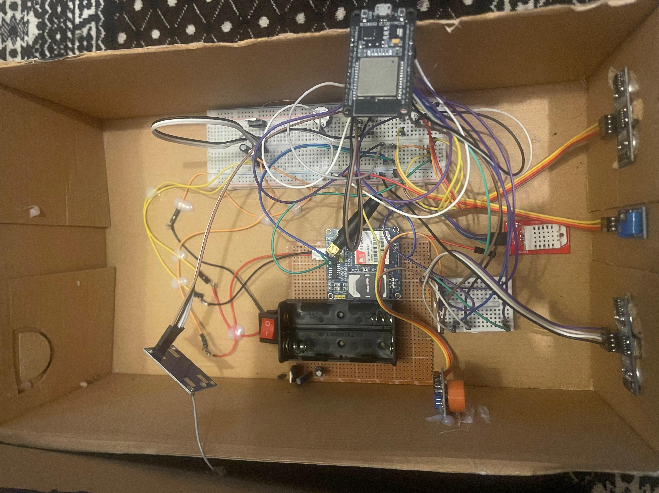
Final Prototype

Slide 12
Components
ESP32 Devkit – Microcontroller
Temperature Sensor – For monitoring vehicle temperature
Alcohol sensor –for detecting alcohol
Vibration Sensor – To detect sudden movements or impacts
GPS Module – For real-time vehicle location tracking
GSM Module – For sending alerts via SMS

Slide 13
L298N Motor Driver – For controlling motor speed and direction
Switches – For manual control and system reset
LEDs
Cables and Connectors – For wiring and connections
Battery (Li-ion) – For powering the system

Slide 14
Results and Discussion
Results
Successfully integrated a multi-sensor system (alcohol, temperature, vibration, ultrasonic) with ESP32 for real-time vehicle monitoring.
Implemented real-time location tracking using GPS and alert generation via GSM for emergency scenarios.
Achieved a functional prototype capable of enhancing road safety, emergency responsiveness, and driver awareness through automation and alerting.
GSM successful

Slide 15
Discussion
Effectiveness
The system meets its goal: to monitor driver behavior (alcohol use), vehicle safety (vibration detection), and environmental awareness (ultrasonic sensors).
The use of GSM and GPS adds valuable remote monitoring capability.
Limitations
GSM signal reliability may vary based on location.
Alcohol sensor needs warm-up time for accurate readings.
Ultrasonic accuracy can drop in rain or rough terrain.
Battery life could be extended with power optimization techniques (e.g., deep sleep mode).

Slide 16
Possible Improvements
Add a camera module for visual feedback.
Incorporate machine learning for behavior prediction.
Use a solar charging module to enhance battery life.
Introduce an app interface for better alert management and historical tracking.

Slide 17
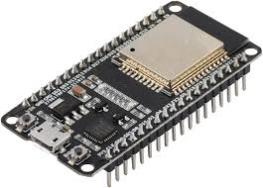
1.ESP32 Devkit (Microcontroller)
Key Characteristics:
Processor: Dual-core 32-bit Xtensa LX6
Clock Speed: Up to 240 MHz
RAM: 520 KB SRAM
Flash Memory: 4 MB
Connectivity: Wi-Fi, Bluetooth
I/O Pins: 34 GPIO pins
Power Requirements:
Operating Voltage: 3.3V
Typical Current: 100-300 mA (depending on usage)

Slide 18
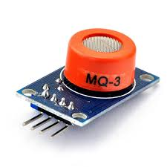
2.Alcohol Sensor (MQ3)
Key Characteristics:
Range: 0.05 to 10 mg/L (ethanol)
Sensitivity: High sensitivity to alcohol
Resolution: Detects alcohol vapor concentrations in air
Power Requirements:
Operating Voltage: 5V
Typical Current: 150-200 mA (heating element)

Slide 19
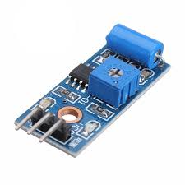
3.Vibration Sensor (SW-420)
Key Characteristics:
Range: Detects vibrations from 1g to 10g (depending on sensitivity adjustment)
Sensitivity: Adjustable via a potentiometer
Power Requirements:
Operating Voltage: 3.3V to 5V
Typical Current: 15-20 mA
4.Switches (For manual control and system reset)
Key Characteristics:
Type: Mechanical pushbutton or toggle switches
Current Rating: Typically 10A or less, depending on the switch type
Power Requirements: Minimal, typically low current (<10 mA)

Slide 20
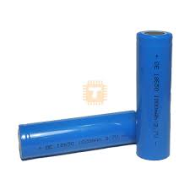
5.Battery (Li-ion)
Key Characteristics:
Voltage: 3.7V (nominal), 4.2V (fully charged)
Capacity: 2000-3000 mAh (typical)
Discharge Current: 1A to 2A (depending on battery specifications)
Power Requirements: Provides power to all components, must match total consumption
6.Capacitor (10 µF)
Key Characteristics:
Type: Electrolytic or Ceramic (commonly ceramic for stability and size)
Capacitance: 10 microfarads (µF)
Voltage Rating: Typically 16V or 25V (must be higher than the working voltage)
Power Requirements: Passive component; no power consumption, but critical for reliable operation of ICs and regulators.

Slide 21
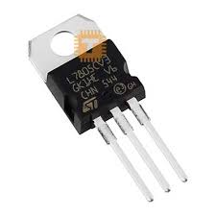
7.Voltage Regulator (5V )
Key Characteristics:
Output Voltage: 5V DC
Input Voltage: 6.5V to 12V (depending on regulator type)
Current Rating:
AMS1117-5.0: Max ~800 mA
7805: Max 1A to 1.5A with proper heat sinking
Dropout Voltage:
AMS1117: ~1.1V (low dropout)
7805: ~2V (standard)
Power Dissipation: Depends on input-output voltage difference and current draw; requires heat sink if dissipating significant power.
Power Requirements: Input power must be sufficient to support load current plus losses (P = (Vin - 5V) × I_load).

Slide 22
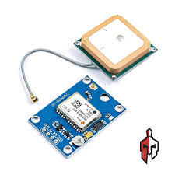
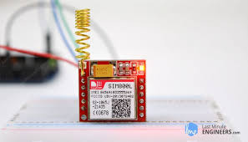
8.GPS Module (Neo-6M)
Key Characteristics:
Range: Latitude: -90° to 90°, Longitude: -180° to 180°
Accuracy: 2.5 meters (typical)
Resolution: 1 meter
Power Requirements:
Operating Voltage: 3.3V to 5V
Typical Current: 30-50 mA
9.GSM Module (SIM800L)
Key Characteristics:
Frequency Range: 850/900/1800/1900 MHz
Data Speed: GPRS, 9600 bps
Transmission Power: 2W (Max)

Slide 23
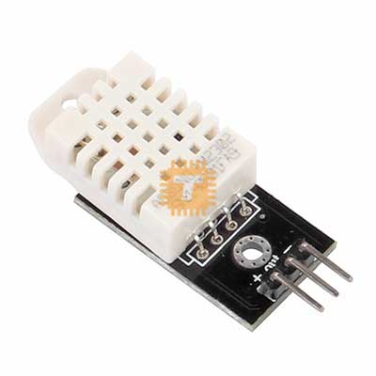
Power Requirements:
Operating Voltage: 3.4V to 4.4V
Typical Current: 20-30 mA (idle), up to 2A (during transmission)
10.Temperature and Humidity Sensor (DHT22)
Key Characteristics:
Range:
Temperature: -40 to 80°C
Humidity: 0-100% RH
Sensitivity: ±0.5°C (temperature), ±2-5% RH (humidity)
Resolution: 0.1°C (temperature), 1% RH (humidity)
Power Requirements:
Operating Voltage: 3.3V to 6V
Typical Current: 1-2 mA (idle), up to 1.5-3 mA (measuring)

Slide 24
11.LEDs (For visual alerts)
Key Characteristics:
Color: Red, green, blue (depending on usage)
Forward Voltage: Typically 2V to 3.2V (depending on the color)
Current Rating: 20 mA per LED
Power Requirements:
Operating Voltage: 3.3V to 5V
Typical Current: 20 mA per LED

Slide 25
Power Requirements per Component
ESP32 Devkit | Voltage(V) | Current(Ma) | Power (W) = V × A
ESP32 Devkit | 3.3V | 100-300 | 0.33-0.99
DHT22 Sensor | 3.3/5V | 1-3 | 0.005-0.015
MQ3 Alcohol Sensor | 5V | 150-200 | 0.75-1.0
HW 028 Rain Sensor | 5V | 30-50 | 0.15-0.25
SW-420 Vibration Sensor | 3.3V/5V | 15-20 | 0.05-0.1
Switches | - | Negligible | ~0
LEDs (3 LEDs) | 3.3V / 5V | 20mA × 3 | 0.06 - 0.09
Servo Motors (2x) | 5V | 5V | 2 - 5 (total)
MPU6050 Gyroscope | 3.3V | 3.9 | 0.0128
LCD Display (16x2 or 20x4) | 5V | 30-50 | 0.15 - 0.25
GPS Module (Neo-6M) | 3.3V / 5V | 30-50 | 0.15 - 0.25
GSM Module (SIM800L) | 3.7V / 4.2V | 20-30 (idle) / 2000 (Tx) | 0.074 - 8.4 (peak)

Slide 26
Problems Encountered and Solutions
Issues Faced During Development
Inconsistent Sensor Readings- Sensors like the MQ3 (alcohol) and temperature showed variable outputs under fluctuating environmental conditions.
GPS Signal Accuracy- The GPS module struggled to maintain precise location indoors or near obstructed zones.
GSM Module Failure: GSM module (SIM900A) initially failed to function due to its high voltage sensitivity it did not receive a stable 5V power supply.

Slide 27
Troubleshooting And Corrective Measures Taken
Sensor Calibration- Adjusted sensor thresholds for optimal sensitivity
GPS Improvement- Repositioned the GPS antenna for better satellite visibility
GSM Voltage Fix- Used a stable external power source (regulated 5V) and added decoupling capacitors to address the GSM module’s voltage sensitivity and ensure consistent performance.
GSM Configuration Optimization- Adjusted AT commands and baud rate for reliable SMS transmission

Slide 28
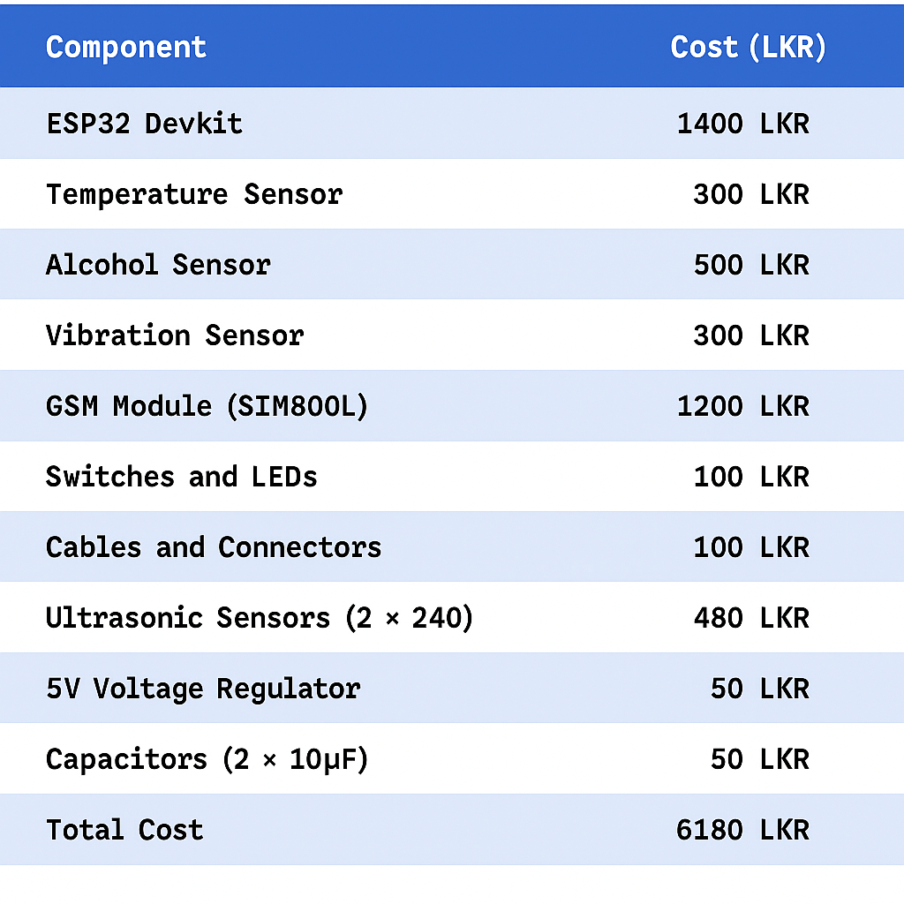
Cost Estimation

Slide 29
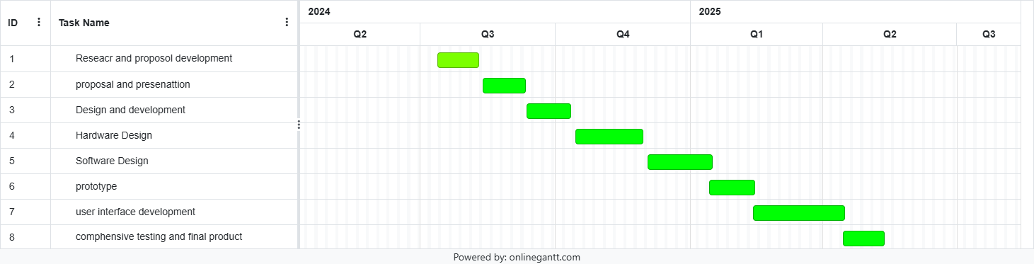
Gantt Chart

Slide 30
References
An IoT-based smart system for the detection, notification and prevention of vehicle accidents, Shohag Barman, Md. Ferdous Bin Hafiz, Niaz Ashraf Khan , 2024 6th International Conference on Electrical Engineering and Information & Communication Technology (ICEEICT) Military Institute of Science and Technology (MIST), Dhaka-1216, Bangladesh [1]
Design and Development of a Vehicle Safety Detection and Alarm System Zhang Fuyan, Li Yingda Department of Computer Science and Technology, Dalian Neusoft University of Information, Dalian, 116023, China[2]

Slide 31
Smart Vehicle Safety Monitoring System Using CAN Protocol Rachana Khamamkar1, Ashru Jadhav2, Shreyas Thoke3, Prof. Girish Chaple4 1,2,3,4Department of Electronics and Telecommunication, 1,2,3,4Pune Institute of Computer Technology, Pune, Maharashtra, India.[3]
IoT-Based Smart Accident Detection and Alert System C. V. Suresh Babu Hindustan Institute of Technolgy and Science, India Akshayah N. S. Hindustan Institute of Technology and Science, India Maclin Vinola P. Hindustan Institute of Technology and Science, India R. Janapriyan Hindustan Institute of Technology and Science, India[4]
IoT based smart emergency response system (SERS) for monitoring vehicle, home and health status Abu S. M. Mohsin BRAC University Munyem Ahammad Muyeed BRAC University[5]

Slide 32
THANK YOU

